Slide 1


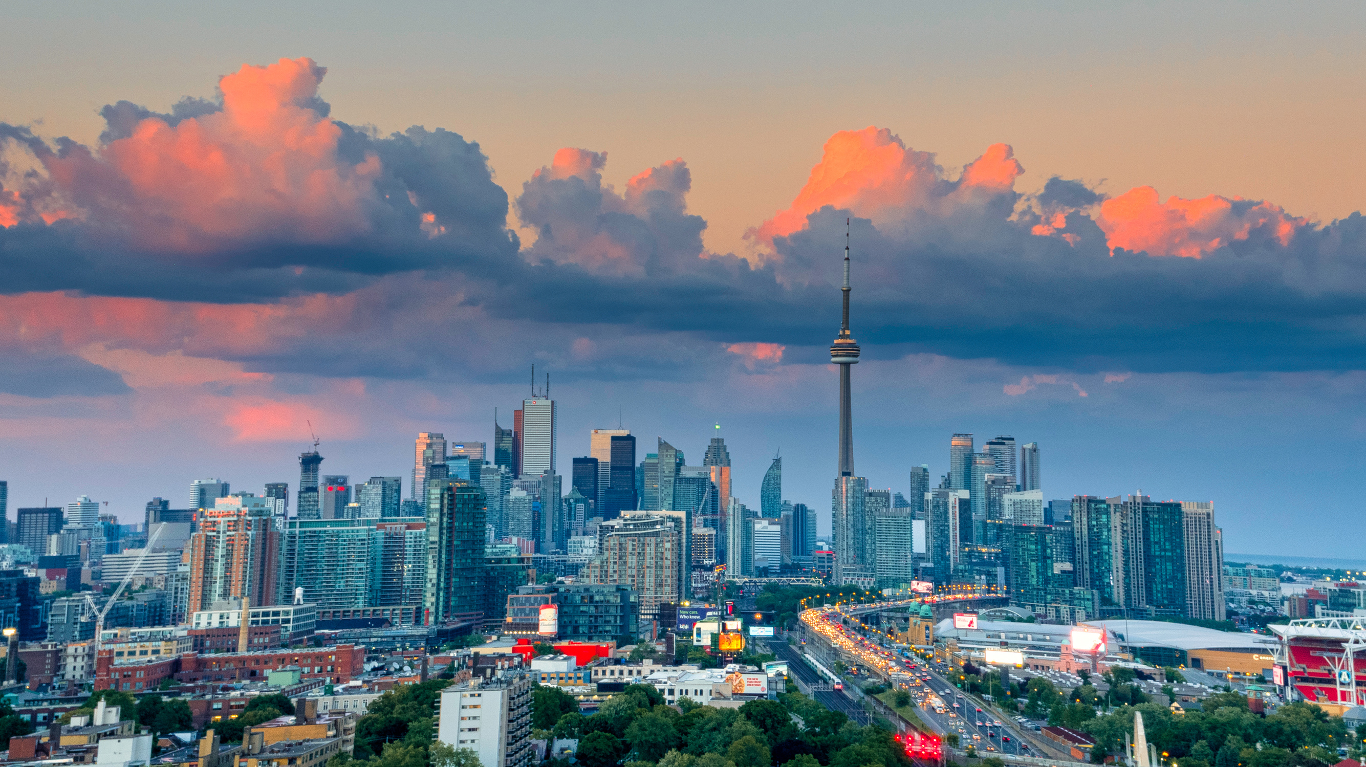
Cohesion Technology
how do we use the digital world to bring people together in meatspace?
-

Slide 2
two kinds of cohesion
local cohesion
network cohesion
“glocal“ cohesion

Slide 3
I. Organizing
Event hosting
Superconnectors
Community builders

Slide 4
event hosting
local events
interest-based events
community-driven events

Slide 5
what is a superconnector?

Slide 6
community building
curation
outreach
“being in the heartbeat of people’s lives”- Pat Con

Slide 7
II. Outreach
aggregation
advertising
socializing

Slide 8
aggregation
event aggregators
community listings
social media

Slide 9
examples

Slide 10
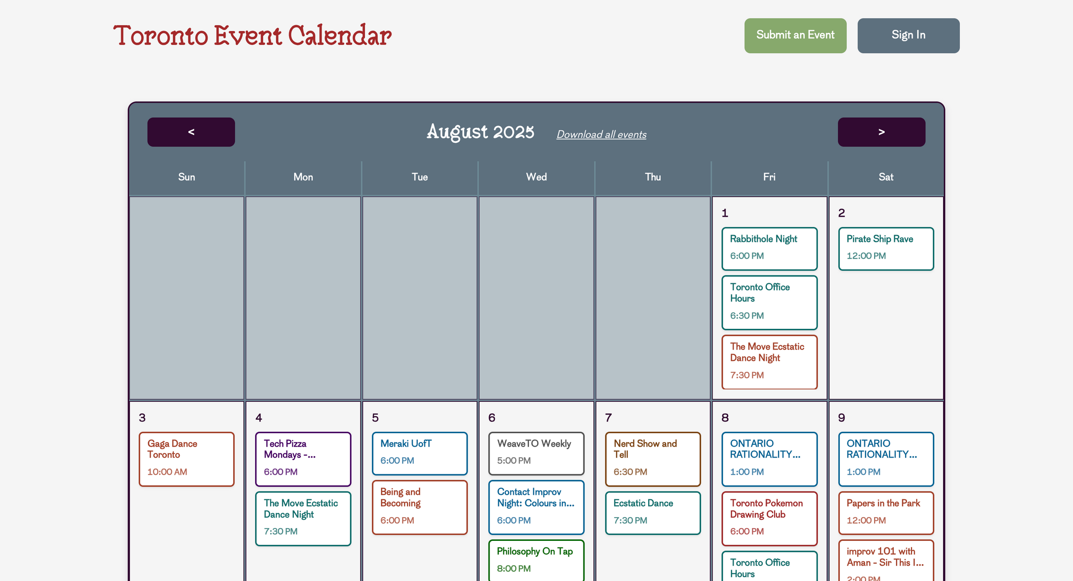

Slide 11
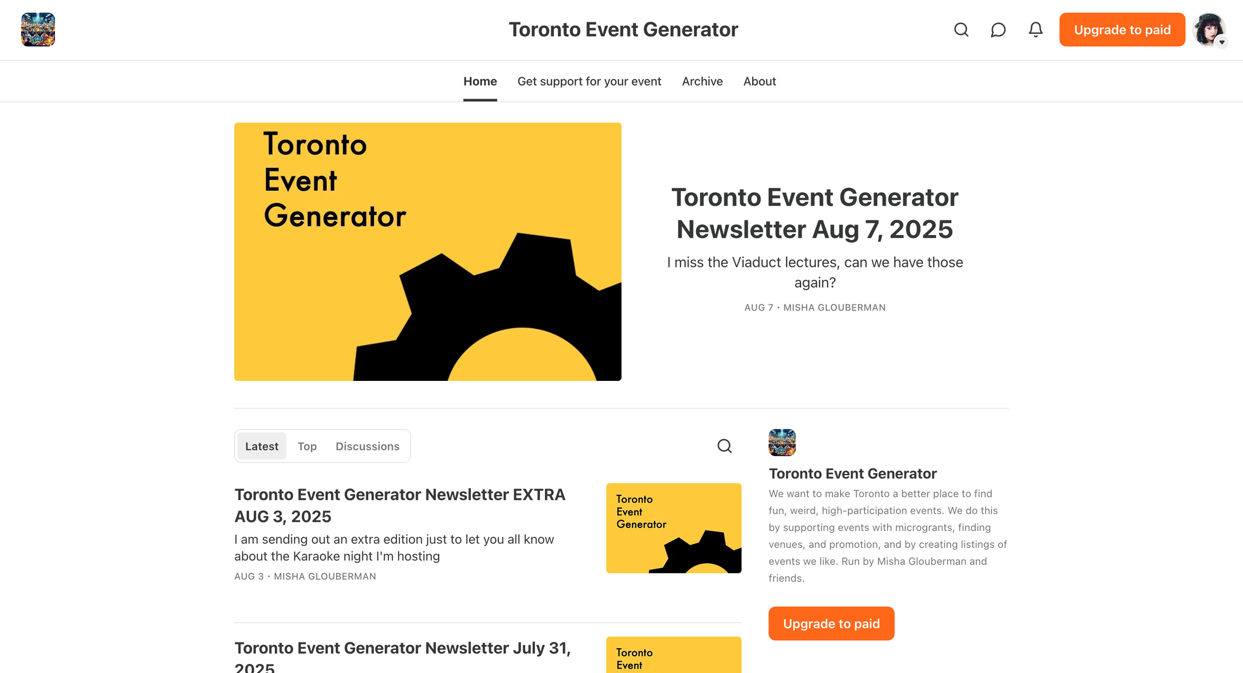

Slide 12
social media
meetup groups
private social media
open source social media

Slide 13
advertising
audience
best practices for outreach
collaboration

Slide 14
socializing
connection
consistency
calibrated commitment

Slide 15
our project(s)
event map
event-based social media
event aggregation

Slide 16
feedback!
-

